Slide 1

Programming GPUs with CUDA:
Introduction to CUDA
Lara Querciagrossa, Andrew Emerson, Nitin Shukla, Luca Ferraro, Sergio Orlandini
l.querciagrossa@cineca.it
July 12th, 2022

Slide 2


In this lecture…
What is CUDA
CUDA process flow
CUDA kernel
Compiling CUDA programs
Execution model
Kernel launch
CUDA-provided thread hierarchy variables
Global index

Slide 3


CUDA overview

Slide 4
Compute Unified Device Architecture
CUDA is a general purpose parallel computing platform and programming model created by NVIDIA.
It consists of:
a hierarchical multi-threaded programming paradigm that matches GPU hardware structure,
a set of extensions to higher level programming languages (C/C++ and Fortran) to use GPU as a coprocessor for heavy parallel task and to express thread parallelism within a familiar programming environment,
a new architecture instruction set called PTX (Parallel Thread eXecution) to match GPU typical hardware,
a developer toolkit to compile, debug, profile programs and run them easily in a heterogeneous systems,
a set of GPU accelerated libraries for common scientific algorithms
Notes:
Register = small amount of fast storage

Slide 5
Compute Unified Device Architecture
CUDA C/C++ and FORTRAN API allow you to:
control and query available GPU devices,
manage GPU memory allocation and data transfers,
manage and control independent work queues,
define special language extension to express thread parallelism of selected functions (kernel) which will be executed on the GPU by thousands of threads.
The SDK includes:
drivers, runtimes and API,
compiler wrappers for compiling cuda code (nvcc),
libraries (cuBLAS, cuFFT, cuSolver, etc),
debuggers (cuda-gdb, cuda-memcheck), profilers (nvprof, nView), etc.
Notes:
Register = small amount of fast storage

Slide 6
CUDA process flow

Slide 7
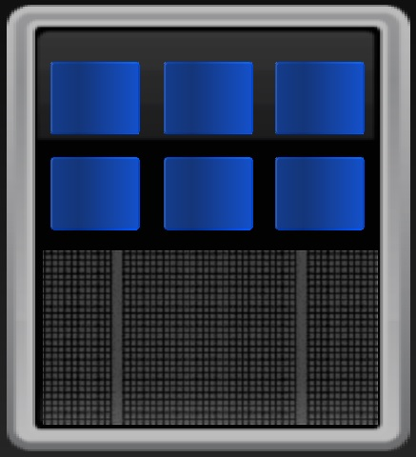
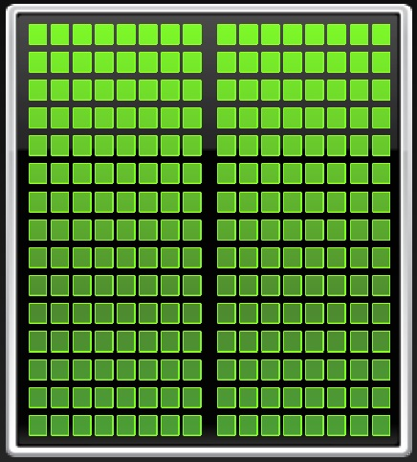
Basic 3-step process
Heterogeneous computing
CPU
GPU
HOST
DEVICE
Notes:
Register = small amount of fast storage

Slide 8
Basic 3-step process
Copy input data from CPU memory to GPU memory
CPU
GPU
Notes:
Register = small amount of fast storage

Slide 9
Basic 3-step process
Copy input data from CPU memory to GPU memory
Load GPU program and execute it
KERNEL
CPU
GPU
Notes:
Register = small amount of fast storage

Slide 10
Basic 3-step process
Copy input data from CPU memory to GPU memory
Load GPU program and execute it
Copy back results from GPU memory to CPU memory
CPU
GPU
Notes:
Register = small amount of fast storage

Slide 11
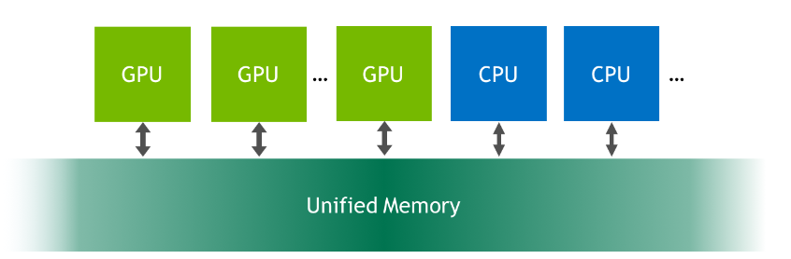
CUDA Unified Memory
Introduced with CUDA 6
Managed memory is accessible to both the CPU and GPU using a single pointer.
The system automatically migrates data allocated in Unified Memory between host and device
Up to GPU Memory Size (CUDA 8+: allocate up to system memory size)
https://developer.nvidia.com/blog/unified-memory-in-cuda-6/
Notes:
Register = small amount of fast storage

Slide 12
CUDA Unified Memory benefits
Simpler Programming and Memory Model:
Single allocation, single pointer, accessible everywhere
Eliminate the need of explicit copy
Simplify code porting
Performance Through Data Locality:
Migrate data to accessing processor (complexity kept under the covers)
Guarantee global coherence
Still allow explicit hand tuning (the CUDA runtime never has as much information as the programmer does about where data is needed and when!) → CUDA 8+ explicit prefetching API
Notes:
Register = small amount of fast storage

Slide 13
CUDA kernels

Slide 14
CUDA kernels
Functions running on GPU are called kernel
#include <stdio.h>
void onCPU() {
printf("This function runs on CPU\n");
}
int main() {
onCPU();
}
#include <stdio.h>
__global__
void onGPU() {
printf("This function runs on GPU\n");
}
int main() {
onGPU<<<1, 1>>>();
cudaDeviceSynchronize();
}
Notes:
Register = small amount of fast storage

Slide 15
CUDA kernels definition
.cu is the file extension for CUDA-accelerated program
Keyword __global__
Indicates that the function will run on GPU
Can be invoked globally (both by CPU and GPU)
It is required that a function defined with __global__ returns void
Device code
#include <stdio.h>
__global__
void onGPU() {
printf("This function runs on GPU\n");
}
int main() {
onGPU<<<1, 1>>>();
cudaDeviceSynchronize();
}
Notes:
Register = small amount of fast storage

Slide 16
CUDA kernel launch
Kernel launch
Function call to run on GPU
Must provide an execution configuration with the syntax <<<…>>> prior to passing kernel arguments
Specify the thread hierarchy for kernel launch
number of blocks (group of threads)
number of threads per block (limited to 1024!!)
#include <stdio.h>
__global__
void onGPU() {
printf("This function runs on GPU\n");
}
int main() {
onGPU<<<1, 1>>>();
cudaDeviceSynchronize();
}
Notes:
Register = small amount of fast storage

Slide 17
CUDA synchronization
Launching kernels is asynchronous: CPU code will continue to execute without waiting for kernel to be completed
cudaDeviceSynchronize() will force the host to wait until device code completeness
#include <stdio.h>
__global__
void onGPU() {
printf("This function runs on GPU\n");
}
int main() {
onGPU<<<1, 1>>>();
cudaDeviceSynchronize();
}
Notes:
Register = small amount of fast storage

Slide 18
Compiling CUDA programs

Slide 19
Prepare your environment
Load CUDA, on CINECA cluster:
module load cuda
Information on CUDA device (System Management Interface):
nvidia-smi
Compiler:
nvcc --arch=sm_70 -o first_kernel 1_cuda_first_kernel.cu -run
The host code will be compiled by the host compiler; while the device code will be processed by NVIDIA compiler.
--arch flag indicates for which architecture the code should be compiled (sm_70 is for TESLA V100 GPU)
--run flag executes the successfully compiled binary
Notes:
Register = small amount of fast storage

Slide 20
Your first exercise: 1_cuda_first_kernel
What is the output of your first CUDA program?
What happens if you remove the __global__ keyword from the kernel?
What happens if your remove the configuration from your kernel launch?
What happens if you remove the call to cudaDeviceSynchronize() ?
Notes:
Register = small amount of fast storage

Slide 21
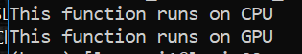
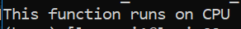
Exercise: 1_cuda_first_kernel
What is the output of your first CUDA program?
What happens if you remove the __global__ keyword from the kernel?
What happens if your remove the configuration from your kernel launch?
What happens if you remove the call to cudaDeviceSynchronize() ?
Notes:
Register = small amount of fast storage

Slide 22
Execution model

Slide 23
GPU work hierarchy
Grid: a collection of thread blocks (first level)
Thread blocks do not synchronize with each other.
Communication between blocks is expensive.
Thread Block: a group of threads
Threads within a block can cooperate (light-weight synchronization).
Thread: a sequential execution unit
All threads execute same sequential program.
Threads execute in parallel.
A “warp” is a set of 32 threads which execute the same instruction.
Software
...
Grid
Thread Block
Thread
Notes:
Register = small amount of fast storage

Slide 24
GPU execution model
Software
Hardware
When a CUDA kernel is invoked:
- thread blocks are assigned to SMs in a round robin mode;
- the thread block remains on the SM until all its threads have finished (no communication between thread blocks).
Threads of each thread block are partitioned into warps of consecutive threads.
Each thread in a warp executes the same instruction simultaneously, with each thread being managed by one GPU core.
...
Grid
GPU
Thread Block
Streaming Multiprocessor
GPU core
Thread
Notes:
Register = small amount of fast storage

Slide 25
Warp scheduler
NVIDIA SM schedules threads in warps (groups of 32 threads).
Warp schedulers allows warps to be issued and executed concurrently if hardware resources are available.
Volta SM has 4 warp schedulers, each one is responsible for:
feeding 32 CUDA cores,
8 load/store units,
8 special functions unit.
Notes:
Register = small amount of fast storage

Slide 26
Transparent scalability
Device
SM1
SM2
Kernel grid
Block 0
Block 1
Block 0
Block 1
The GPU runtime system can execute blocks in any order relative to each other.
This flexibility enables to execute the same application code on hardware with different numbers of SMs.
Block 2
Block 3
Block 2
Block 3
Block 4
Block 5
Block 4
Block 5
Block 6
Block 7
Block 6
Block 7
Device
SM1
SM2
SM3
SM4
time
Block 0
Block 1
Block 2
Block 3
Block 4
Block 5
Block 6
Block 7
Notes:
Register = small amount of fast storage

Slide 27
Hiding latencies
Latency is the number of clock cycles needed to complete an instruction, aka the number of cycles we need to wait for before another dependent operation can start:
arithmetic latency (~ 18-24 cycles),
memory access latency (~ 400-800 cycles).
Latency can not be discarded (hardware limitation), but its effect can be controlled (hidden) by:
saturating computational pipelines in computational bound problems,
saturating bandwidth in memory bound problems.
Notes:
Register = small amount of fast storage

Slide 28
Hiding latencies
The code need to be organized to provide the scheduler a sufficient number of independent operations.
There are two possible ways and paradigms to use, that can be combined:
Thread-Level Parallelism (TLP):
- high SM occupancy: provide as much threads per SM as possible
(when a scheduler is free it will find easily a warp to execute)
- best approach for low
number of independent
operations per CUDA
kernel
Notes:
Register = small amount of fast storage

Slide 29
Hiding latencies
The code need to be organized to provide the scheduler a sufficient number of independent operations.
There are two possible ways and paradigms to use, that can be combined:
Thread-Level Parallelism (TLP)
Instruction-Level Parallelism (ILP)
- high number of multiple independent
operations inside CUDA kernel
(each kernel act on a lot of data)
- this will grant the scheduler to stay
on the same warp and fully load
each hardware pipeline
Notes:
Register = small amount of fast storage

Slide 30
Kernel launch

Slide 31
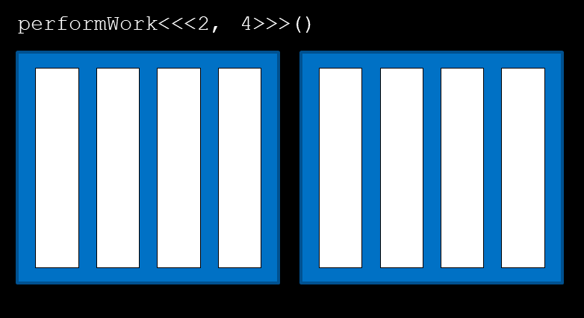

Kernel execution
kernel<<<number_of_blocks, number_of_threads_per_block>>>();
thread
Many threads run in parallel!
Notes:
Register = small amount of fast storage

Slide 32
Kernel execution
kernel<<<number_of_blocks, number_of_threads_per_block>>>();
block: collection of threads
Every block of the grid contains the same number of threads!
Notes:
Register = small amount of fast storage

Slide 33
Kernel execution
kernel<<<number_of_blocks, number_of_threads_per_block>>>();
grid: collection of blocks
Notes:
Register = small amount of fast storage

Slide 34
Kernel execution
kernel<<<number_of_blocks, number_of_threads_per_block>>>();
kernel<<<1, 1>>>() is configured to run in a single thread block which has a single thread, therefore it will run only one.
kernel<<<1, 10>>>() is configured to run in a single thread block which has 10 threads, therefore it will run 10 times.
kernel<<<10, 1>>>() is configured to run in 10 thread blocks which each have a single thread, therefore it will run 10 times.
kernel<<<10, 10>>>() is configured to run in 10 thread blocks each of which has 10 threads, therefore it will run 100 times.
Notes:
Register = small amount of fast storage

Slide 35
Exercise: 2_first_parallel.cu
Refactor firstParallel function to be launched as CUDA kernel.
Rearrange the execution configuration to run the kernel in parallel on 5 threads, in a single thread block. How many times is the message printed?
Rearrange the execution configuration to run the kernel in parallel on 3 thread blocks, each containing 5 threads. How many times is the message printed?
Notes:
Register = small amount of fast storage

Slide 36
CUDA-provided thread hierarchy variables

Slide 37
Thread hierarchy variables
gridDim.x: number of blocks in the grid
2
Notes:
Register = small amount of fast storage

Slide 38
Thread hierarchy variables
blockIdx.x: index of current block within the grid
0
Notes:
Register = small amount of fast storage

Slide 39
Thread hierarchy variables
blockIdx.x: index of current block within the grid
1
Notes:
Register = small amount of fast storage

Slide 40
Thread hierarchy variables
blockDim.x: number of threads per block
4
All blocks in a grid contain the same number of threads.
Notes:
Register = small amount of fast storage

Slide 41
Thread hierarchy variables
threadIdx.x: index of the thread within a block
0
1
3
0
1
0
1
2
3
0
2
3
2
All blocks in a grid contain the same number of threads.
Notes:
Register = small amount of fast storage

Slide 42
Exercise: 3_understand_threadIdx_blockIdx.cu
Refactor the code so that a “Success” message is printed.
Exercise: 4_accelerating_loops.cu
Refactor the code so that the function doLoop() will run on GPU.
Refactor the kernel so that each iteration can be run in parallel. The new kernel should only do the work of one iteration of the original loop. Use a single block of threads. Numbers from 0 to N should be printed, as for the CPU code.
Notes:
Register = small amount of fast storage

Slide 43
Global index

Slide 44
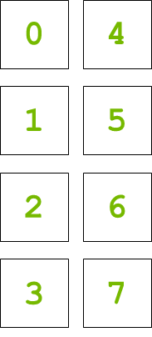
Coordinate parallel threads
Data on GPU
A limited number of threads (1024) can fit inside a thread block.
To increase parallelism, we need to coordinate work among thread blocks.
This is achieved by mapping element of data vector to threads using global index.
Notes:
Register = small amount of fast storage

Slide 45
Global index
threadIdx.x + blockIdx.x * blockDim.x
blockDim.x = 4
blockIdx.x = 1
blockIdx.x = 0
0
1
2
3
0
1
2
3
threadIdx.x
Notes:
Register = small amount of fast storage

Slide 46
Global index
threadIdx.x + blockIdx.x * blockDim.x
dataIdx = 0 + 0 * 4 = 0
0
1
2
3
0
1
2
3
Notes:
Register = small amount of fast storage

Slide 47
Global index
threadIdx.x + blockIdx.x * blockDim.x
dataIdx = 1 + 0 * 4 = 1
0
1
2
3
0
1
2
3
Notes:
Register = small amount of fast storage

Slide 48
Global index
threadIdx.x + blockIdx.x * blockDim.x
dataIdx = 2 + 0 * 4 = 2
0
1
2
3
0
1
2
3
Notes:
Register = small amount of fast storage

Slide 49
Global index
threadIdx.x + blockIdx.x * blockDim.x
dataIdx = 3 + 0 * 4 = 3
0
1
2
3
0
1
2
3
Notes:
Register = small amount of fast storage

Slide 50
Global index
threadIdx.x + blockIdx.x * blockDim.x
dataIdx = 0 + 1 * 4 = 4
0
1
2
3
0
1
2
3
Notes:
Register = small amount of fast storage

Slide 51
Global index
threadIdx.x + blockIdx.x * blockDim.x
dataIdx = 1 + 1 * 4 = 5
0
1
2
3
0
1
2
3
Notes:
Register = small amount of fast storage

Slide 52
Global index
threadIdx.x + blockIdx.x * blockDim.x
dataIdx = 2 + 1 * 4 = 6
0
1
2
3
0
1
2
3
Notes:
Register = small amount of fast storage

Slide 53
Global index
threadIdx.x + blockIdx.x * blockDim.x
dataIdx = 3 + 1 * 4 = 7
0
1
2
3
0
1
2
3
Notes:
Register = small amount of fast storage

Slide 54
Exercise: 5_multi_block_loops.cu
Refactor the code so that the function doLoop() will run on GPU (same starting point as exercise 4_accelerating_loop.cu).
Refactor the kernel so that each iteration can be run in parallel. The new kernel should only do the work of one iteration of the original loop. Use a single block of threads. Numbers from 0 to N should be printed, as for the CPU code.
Additional constraint: use a kernel configuration that launches at least 2 blocks of threads.
How many kernel configurations can be used to solve this problem? Only one or more than one?
Notes:
Register = small amount of fast storage

Slide 55
References

Slide 56

References
Previous editions of this school at CINECA
Oakridge National Laboratory’s “Introduction to CUDA C++”: https://www.olcf.ornl.gov/calendar/introduction-to-cuda-c/
NVIDIA DL Institute Online Course: main source of exercises
blogs.nvidia.com
unsplash.com
Wikipedia

Slide 57
THANK YOU!
Lara Querciagrossa
l.querciagrossa@cineca.it

